Slide 1
Time Tracking and Task Management
Project Supervisor: Kevin O’Neil
Team Members: Karanbir Singh
Mohammad Ali
Agyapal Singh
Ramandeep Kaur
For Silver Servers

Slide 2
Languages used:
PHP
JavaScript
jQuery
Ajax
HTML
CSS
MySql(for database)

Slide 3

How it works:
View
Frontend
Controller
Model
Database
Frontend Interacts with controller
Controller→ handles all the requests from user,
Controller then interacts with model.
Model responds to all the user requests, as well as interacts with the database

Slide 4
Structure:
Individual Task List
Employee
Create Task
USERS
Employee task list
Admin
Generate Report
Ali → Will talk on employee task list
Agyapal → will talk on create list
Raman→ will talk on Generate report and
Employee task list
Manage Users

Slide 5
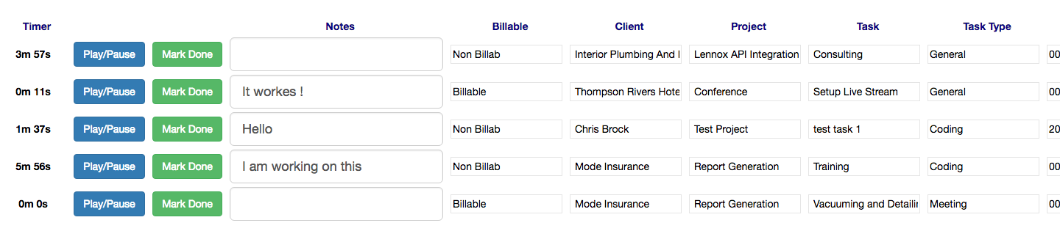
Employee phase:
- Display all tasks ” created by employee or admin”.
- All the values are displayed taken from the database.
- Play or pause only one task at time “ store real time in the database”.
- Update note for specific task.
- Insert note after click Mark Done
- Any changes to the tasks the logs will be updated.

Slide 6
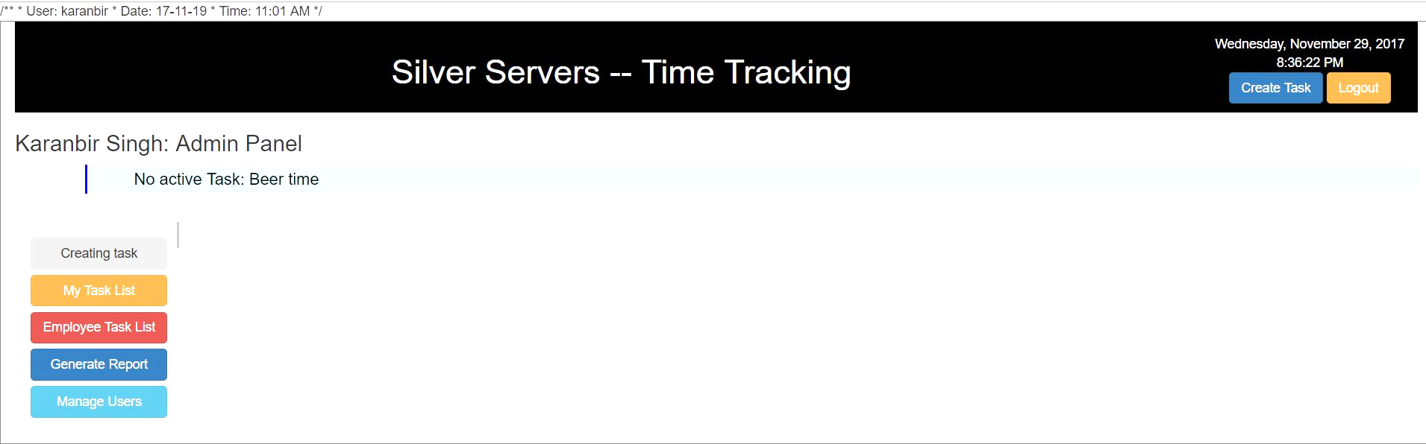
Create Task:
Why?
when ?
Who?

Slide 7
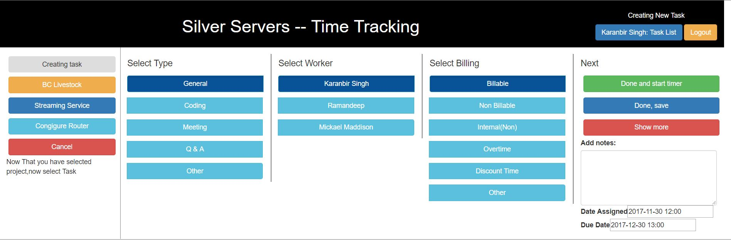
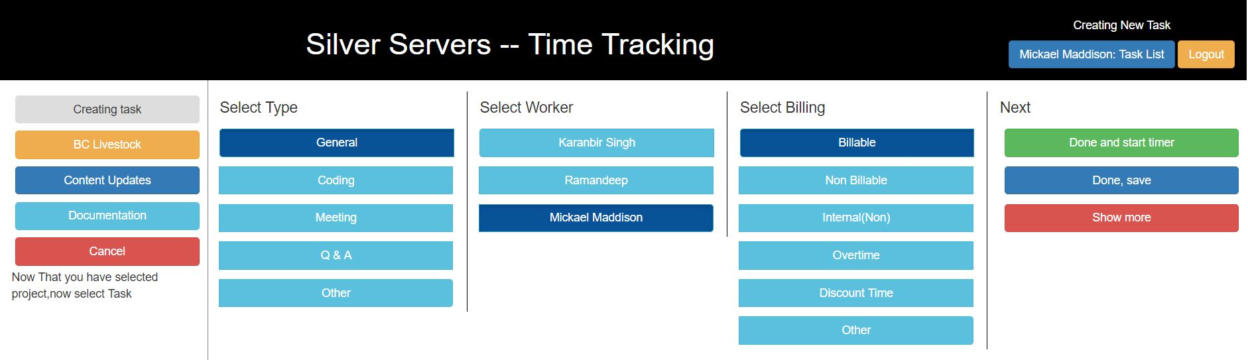
Create Task:Phases
Phase 1 - Filling Fields
Task name
Client name
Project name
Phase 2 - Data Extraction
Auto selected from phase 1
Fields can be modified
Phase 3 - Final steps & Save settings
Type
Workers
Billing
Start timer or just Save it.
Show more options i.e. notes, date assigned & deadlines.

Slide 8
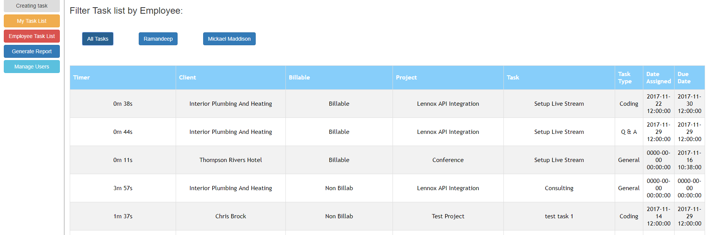
Admin Page

Slide 9
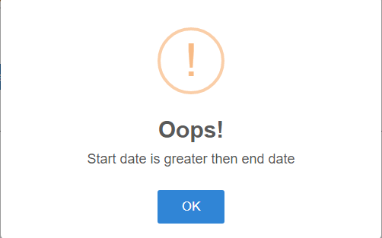
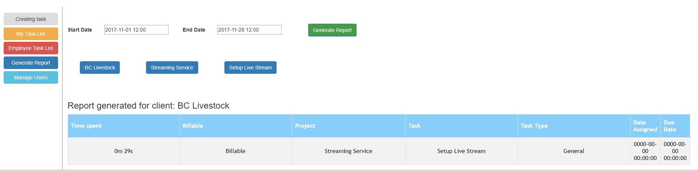
Generate Report
Three Types of Generate Report:
Client
Client + Project
Client + Project + Task
Other features of generate report are:
You can not generate report without choosing clients.
Dates cannot be null
Invalid dates.

Slide 10
Difficulties, Challenges faced during the project
Working with a company
AJAX -- was not a requirement before
Never followed the project description
Parameterized queries(preventing SQL injection attacks)
Using external libraries → DateTimepicker, Sweet alerts etc.
Designing UI

Slide 11

Questions?

